Slide 1



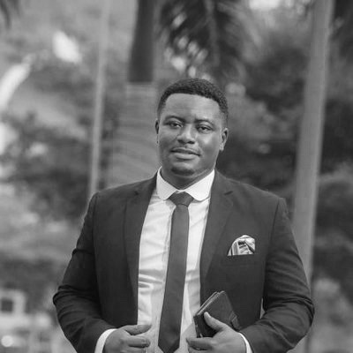
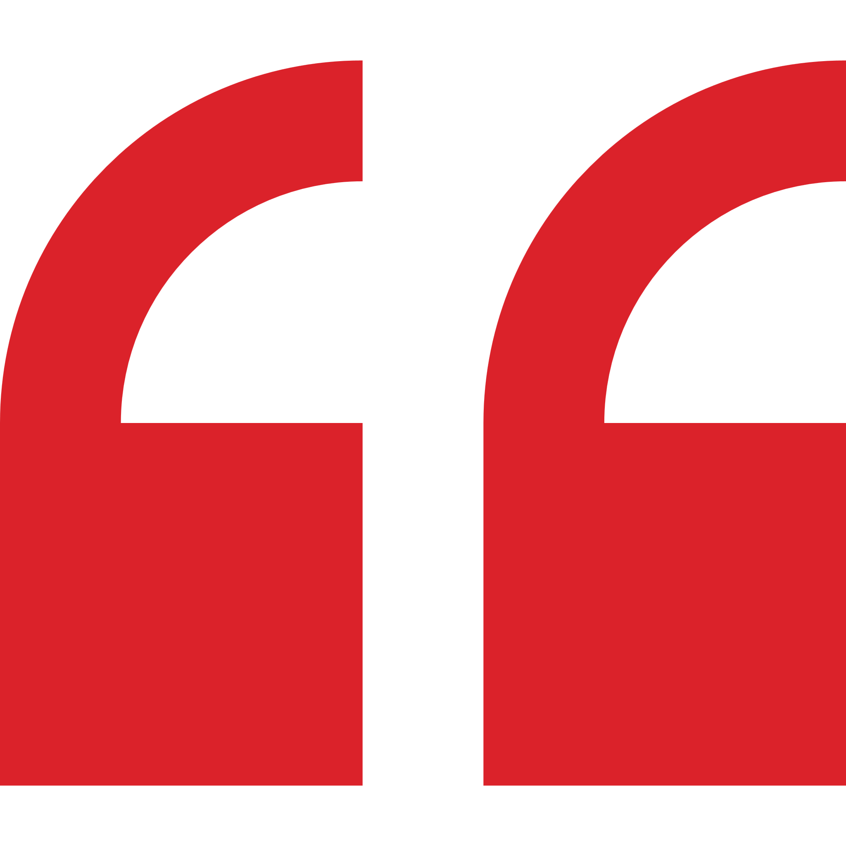
Chris Koney – Key Expert
Professional experience
Education and skills
Currently the Head of Communications for the Royal Commonwealth Society (RCS) Africa
Chris has worked with the Customer Experience team at Vodafone Ghana and served as Senior Media Officer at Charterhouse Productions
He was the Public Relations and Publicity Executive for the pan-African cable television company, MultiChoice Ghana (DStv and GOtv)
Chris has also worked in events and marketing communications at Groupe Nduom, a privately held business group with operations in Africa, Europe and America
Since 2014, Chris been a columnist in the weekend edition of the Business and Financial Times newspaper titled “The Society and You” and also contributes articles to various magazines and lifestyle portals around the world on creative arts and socio-cultural issues
2 years with Shatta Movement Music Production as PR Manager and team leader
Guiding publicity programs and strategies
Advise and counsel in any matters pertaining to publicity, public relations and advertising
Chris holds an MA in Public Relations from the Ghana Institute of Journalism, with a certification in PR, Marketing & Advertising
He also holds a BA in Philosophy and History from the University of Ghana
Chris speaks English, Twi and Ga fluently. He also has a basic knowledge of French
Introduction
Chris is a Ghanaian thought leader in Marketing Communications, Brand & Talent Management with over 10 years of experience in the West African (Ghana, Nigeria and Liberia) and South African entertainment space.
Since 2015, Chris is the PR Manager and team leader of Shatta Movement Music Productions, the record label of Ghana’s popular artist and entertainer Shatta Wale.
As a Key Expert, Chris would be responsible for developing and leading the overall strategy. He would ensure that there is ample communication with the client to support with all aspects of PR and communications in relation to the client’s brand.

